Slide 1
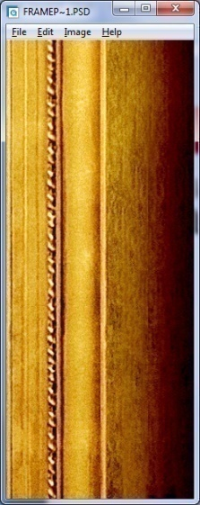
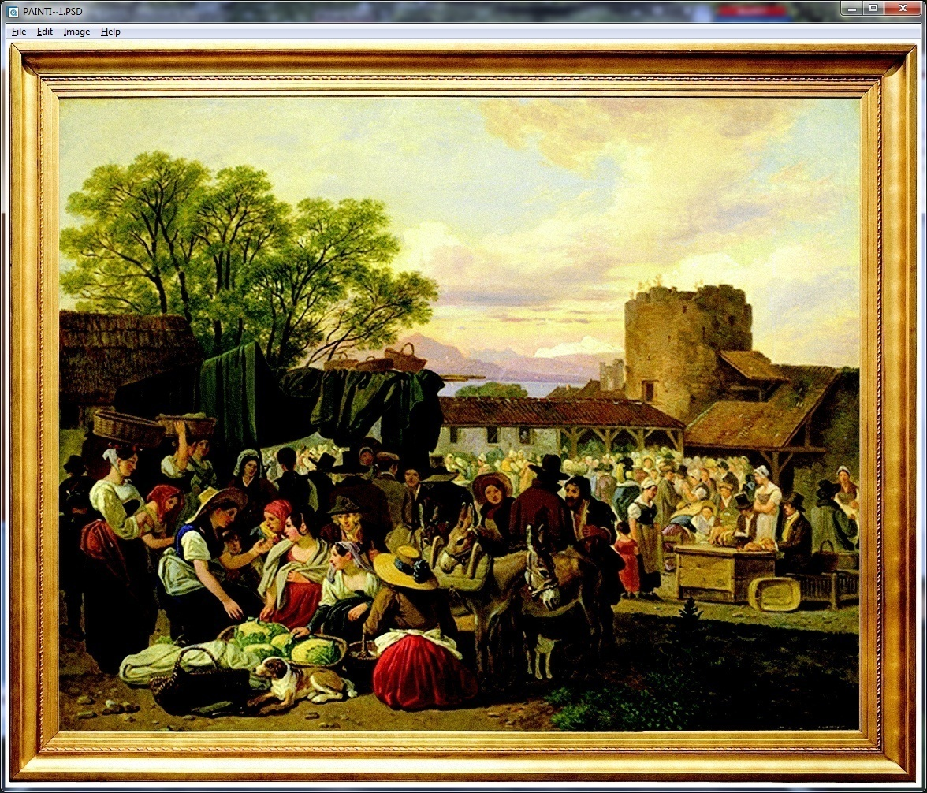
CHAPTER - 2
Principles of
MICROeconomics
(HSS – 1021)
Thinking Like an Economist
N. Gregory Mankiw

Slide 2
Economics educates you to. . . .
Evaluate in terms of alternatives.
Comparing the cost of individual and social
choices.
Investigate and understand the relationship
between different events and issues .

Slide 3
A model usually represents a real life phenomenon in a simplified manner.
So, the economists use models to simplify reality for improving our understanding of the world.
Two of the most basic economic models include:
The Circular Flow Diagram
The Production Possibilities Frontier

Slide 4
The circular-flow diagram is a visual model of the economy that shows the flow of money through markets among households and firms. This model consist of two types ofactors and two types of market.
Two types of actors are:
households
firms
Two markets are:
the market for goods and services
the market for factors of production

Slide 5
What are the factors of Production?
Factors of production: the resources the economy uses to produce goods and services include
labour
land
capital (buildings & machineries used in
the process of production)

Slide 6
Functions of the actors:
Household’s function
Own the factors of production and sell/rent these factors to firms for income
Buy and consume goods and services
Firm’s function
Hire the factors of production and utilise these factors to produce goods and services
Sell the goods and services

Slide 7
MODEL 1: The Circular-Flow Diagram
Revenue
Spending
Markets for Goods & Services
Goods & Services are sold
Goods & Services are bought
Firms
Households
Factors of production
Labor, land, capital
Markets for Factors of Production
Wages, rent, profit
Income
Money Flow
Flow of Goods & Services

Slide 8
Contd..
Imagine a hypothetical economy where there is one firm, i.e., J.K. Agri Genetics Ltd. and household. J.K. Agri Genetics Ltd. Hired 20 labourers at the prevailing wage rate of Rs.400 per day, paid a rent of Rs.2,80,000 per annum and borrowed Rs.40 lakhs at an interest rate of 10% per annum. J.K. Agri Genetics Ltd. Produces 80,000 kg rice per annum and sells it at a price of Rs.45 per kg.
(i) Represent the inter-relationship between the consuming and
producing sector of the above hypothetical economy through
circular flow diagram.
(ii) How much revenue J.K. Agri Genetics Ltd. Is earning during the
year?
(iii) How much income the household is earning during the year?

Slide 9
The Circular Flow -Answer
(i) The inter-relationship between the consuming and producing sector of the given hypothetical economy is represented through the circular flow diagram given below.
Revenue = 36,00,000
Spending =36,00,000
Markets for Goods & Services
J.K. Agri Genetics Ltd.
Households
Markets for factors of Production
Wages(29,20,000), rent (2,80,000) and interest (4,00,000)
Income = 36,00,000

Slide 10

The Circular Flow - Answer
J.K. Agri Genetics Ltd. is earning a revenue of Rs. 36,00,000 (The total production of Rice is 80,000 Kg and the selling price is Rs. 45 per Kg so 80,000*45=36,00,000)
Sum of all factor incomes flowing from J.K. Agri Genetics Ltd. to household in a year is the total income of the household for that year. This includes Rent amount paid by the firm is Rs. 2,80,000 per annum, Wages paid to the labourers is Rs. 400 per day, the firm has employed 20 labourers(400*20* 365 = Rs. 29,20,000) and borrowed 40 lakhs so it has to pay the interest @10% (so the interest amount is = Rs. 4,00,000). Thus, the income of the household is Rs. 2,80,000 + Rs.29,20,000 + Rs. 4,00,000 = Rs. 36,00,000

Slide 11
Our Second Model: The Production Possibilities Frontier
The production possibilities frontier (PPF) is a graph that shows the combinations of output that the economy can possibly produce given the available factors of production (Resources) and the available production technology.
It is feasible to produce any combination of output on or inside the frontier and the points outside the frontier are not feasible within the existing resources . That is why it is called a frontier.
This model graphically demonstrates trade-offs, opportunity costs, and efficiency.
Notes:
14

Slide 12
0
4 Key Assumptions
Only two goods can be produced
Full employment of resources
Fixed resources (Ceteris Paribus)
Fixed technology
Example:
Two goods: laptop and mobile
One resource: labour (measured in terms of hours)
Economy has 50,000 labour hours per month available for production.
Producing one laptop it requires 100 hours of labour.
Producing one mobile it requires 10 hours of labour.
Notes:
12

Slide 13
PPF Example
Production Possibilities | Employment of Resources |  | Production |  | Unit Opportunity Cost (Sacrifice/ Gain)
 | laptop | mobile | laptop | mobile | laptop | mobile
A | 50000 | 0 | 500 | 0 | 1000/100=10 | -
B | 40000 | 10000 | 400 | 1000 | 1500/150=10 | 100/1000=0.1
C | 25000 | 25000 | 250 | 2500 | 1500/150=10 | 150/1500=0.1
D | 10000 | 40000 | 100 | 4000 | 1000/100=10 | 150/1500=0.1
E | 0 | 50000 | 0 | 5000 | - | 100/1000=0.1

Slide 14
PPF Example
Point on graph | Production
 | laptop | mobile
A | 500 | 0
B | 400 | 1,000
C | 250 | 2,500
D | 100 | 4,000
E | 0 | 5,000
E
D
C
B
A
Notes:
14

Slide 15
Exercise: Points off the PPF
I. On a graph, find the point that represents (100 laptops and 3000 mobiles), label it as X. Will it be possible for the economy to produce this combination of these two goods? If yes why and if no why not?
Mobile
E
D
Inefficient
Feasible
Point on graph | Production
 | Laptop | Mobile
A | 500 | 0
B | 400 | 1,000
C | 250 | 2,500
D | 100 | 4,000
E | 0 | 5,000
C
X
Efficient and
Feasible
B
A
Laptop
Notes:
15

Slide 16
Exercise: Points off the PPF
II. Find the point that represents (300 laptops and 3500 mobiles), label it as Y. Will it be possible for the economy to produce this combination of these two goods? Analyse the situation in terms of feasibility and efficiency.
Mobile
E
Impossible/ Unattainable
(given current resources)
D
Y
Point on graph | Production
 | Laptop | Mobile
A | 500 | 0
B | 400 | 1,000
C | 250 | 2,500
D | 100 | 4,000
E | 0 | 5,000
C
Efficient and
Feasible
B
A
Laptop
Notes:
16

Slide 17
The PPF: What We Know So Far
Points on the PPF ( A – E)
It is possible
It is efficient as all resources are fully utilized
Points under the PPF ( X)
It is possible
But it is not efficient as some resources are underutilized (e.g., workers are unemployed and also the factories are idle)
Points above the PPF ( Y)
It is not possible
Notes:
17

Slide 18
The PPF and the Opportunity Cost
The opportunity cost of an item is what you give up to obtain that item.
Moving along a PPF involves shifting resources (e.g., labour) from the production of one good to the other.
Society faces a tradeoff. It means getting more of one good requires sacrificing some of the other resources.
The slope of the PPF describes that the opportunity cost of one good in terms of the other.
Notes:
18

Slide 19
The Shape of the PPF
The PPF can be a straight line or a bow-shaped curve.
It depends on what happens to the opportunity cost as the economy shifts resources from one industry to the other industry.
If opportunity cost remains constant, PPF takes the shape of a straight line. (In the our example opportunity cost of 1 number of laptop is 10 numbers of mobiles.)
If the opportunity cost of a good rises as the economy shifts the resources which means that production of more of the good, so the PPF takes a bow-shape.
Notes:
19

Slide 20
Why the PPF Might Be Bow-Shaped
So, PPF is bow-shaped when different laborers have different skills, different opportunity costs of producing one good in terms of the other good.
The PPF can also be bow-shaped when there is some other resource or mix of resources with different opportunity costs (e.g., different types of land suited for different uses).
Notes:
20
The bow-shaped PPF is more realistic. However, the linear PPF is simpler to work with, and we can learn a lot about how the economy works using the linear PPF. In Chapter 3, we will use a linear PPF to show how trade can make two countries (or two individuals) better off.
Note: In the “Problems and Applications” at the end of the chapter, problem 4 asks students to construct a PPF for an economy with three different workers (Larry, Moe, and Curly), each with a different opportunity cost. The PPF ends up having three line segments (one for each worker), which--very roughly--approximates a bow-shape. After students work through and understand this problem, it should not be hard for them to understand the following: the more different kinds of workers (or, more generally, resources) there are, the closer the PPF will resemble a smooth bow shape. In an actual economy like the U.S., there are millions of different workers with different opportunity costs, so a smooth bow-shaped PPF is a nearly perfect approximation to the actual PPF.

Slide 21
Why the PPF Might Be Bow-Shaped
As the economy shifts resources from Laptop to Mobile:
PPF becomes steeper
opportunity cost of Laptop increases
Laptop
Mobile
Notes:
21

Slide 22
Shifting the Production Possibilities Curve
4 Key Assumptions Revisited
Only two goods can be produced
Full employment of resources
Fixed Resources
Fixed Technology
What will happen if there is a change?
2 Shifters of the PPC
1. Change in resource quantity or quality
2. Change in Technology
Relaxing
Copyright©2003 Southwestern/Thomson Learning

Slide 23
The Production Possibilities Frontier – Change in Resources
Mobile
Increase in Resources:
Suppose the labour hours increased from
50,000 to 70,000 labour hours)
Laptop

Slide 24
The Production Possibilities Frontier – Change in Resources
Decrease in Resources
Mobile
Laptop

Slide 25
The Production Possibilities Frontier – Change in Technology
Economic growth shifts the PPF outward.
With any additional resources or with an improvement in the technology utilised for the production of both the goods, the economy can produce more laptops and more mobiles (any combination in between).
So it leads to increase in the level of production of both.
Notes:
25
The PPF shows the tradeoff between the outputs of different goods at a given time, but the tradeoff can change over time.
For example, over time, the economy might get more workers (or more factories or more land). Or, a more efficient technology might be invented. Both events – an increase in the economy’s resources or an improvement in technology – cause an expansion in the set of opportunities. That is, both allow the economy to produce more of one or both goods.
This is a simple example of economic growth, an important subject that gets its own chapter in the macroeconomics portion of the textbook.
In the example shown on this slide, economic growth causes a parallel outward shift of the PPF. Since the new PPF is parallel to the old one, the tradeoff between the two goods is the same. However, this need not always be the case. For example, if a new technology had more impact on the computer industry than on the wheat industry, then the horizontal (computer) intercept would increase more than the vertical (wheat) intercept, and the PPF would become flatter: the opportunity cost of computers would fall, because the technology has made them relatively cheaper (relative to wheat). Going into more detail here is probably beyond the scope of this chapter.

Slide 26
The PPF: A Summary
The PPF shows all combinations of two goods that an economy can possibly produce, given its resources and technology.
The PPF describes the concepts of tradeoff and opportunity cost, efficiency and inefficiency unemployment, and economic growth.
A bow-shaped PPF illustrates the concept of increasing opportunity cost.
Notes:
26

Slide 27
Summary:
The economists try to explain the world using models with appropriate assumptions.
Two simple models discussed in this chapter are the Circular-Flow Diagram and the Production Possibilities Frontier.
Microeconomics studies the behaviour of consumers and firms, and their interactions in markets.

